Slide 1
BYU-SCUT EXCHANGING PROGRAME
Presented by: (in alphabet order)
Ada
Lucifer
Luke
Michelle
Ronnie*

Slide 2
Contents
Introduction
Exchange Programs SCUT provides
School of Architecture exchanging program
School of Materials exchanging program
SCUT environment
Exchange Program SCUT suggests
School of Management exchanging program
Conclusion

Slide 3

Introduction
25,000 undergraduates and 18,000 postgraduates
Dedicated to educating engineers for 60 years
Ranked 138 worldwide by Leiden in 2013
China’s first-level university
Industry technology, Architecture, Materials Science…

Slide 4

Introduction
One of the largest private universities in U.S.
28,000 undergraduates and 2,000 full-time postgraduates
Ranked 62nd in the U.S. by U.S.News in 2013
Marriott School of Management received a No.5 ranking by Business Week in 2009
MBA program ranked 92nd among business schools worldwide.

Slide 5
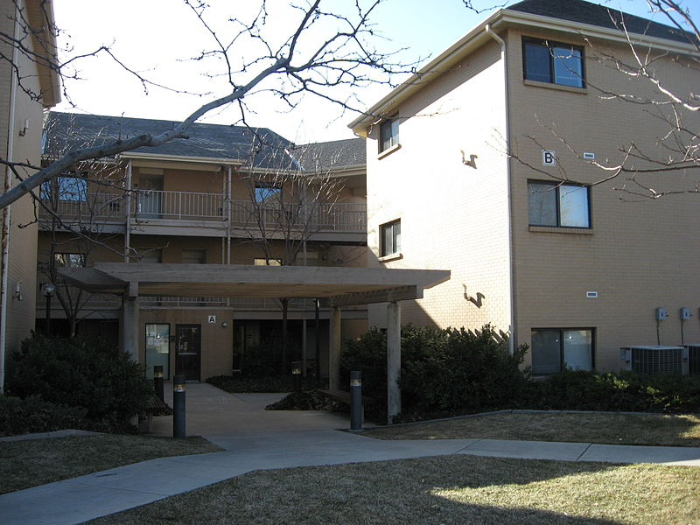
FOUNDATION OF COOPERATION?
Both are worldwide famous universities
For the BYU:
Strong engineering background in SCUT
A longer exchanging program in China
For the SCUT:
A multi-language environment
China needs more specialists
International Students Dormitory

Slide 6
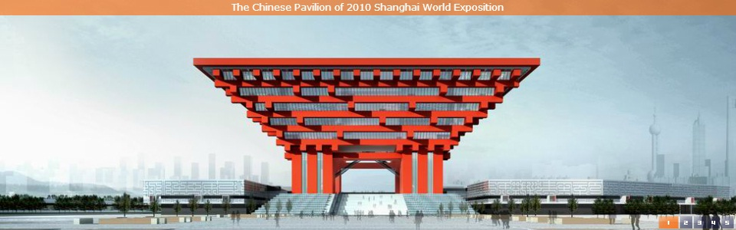
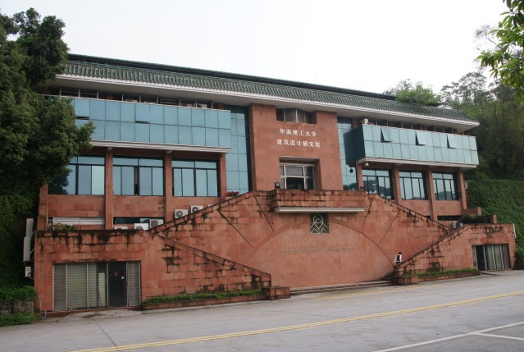
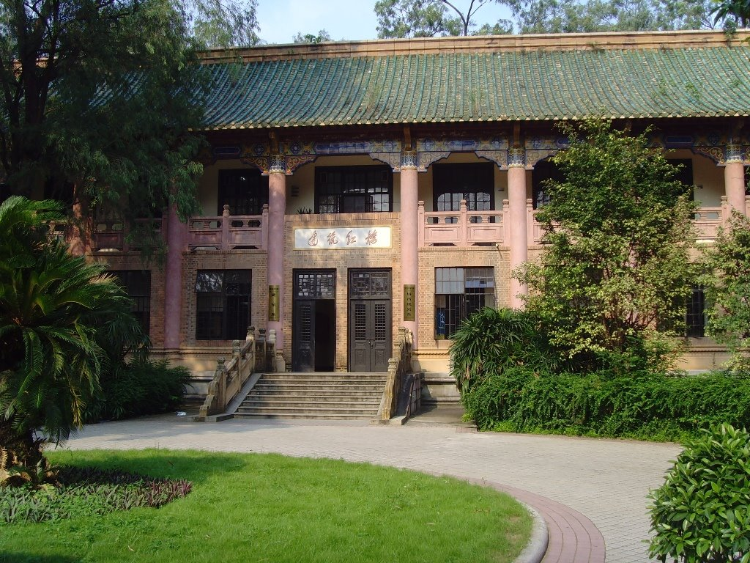
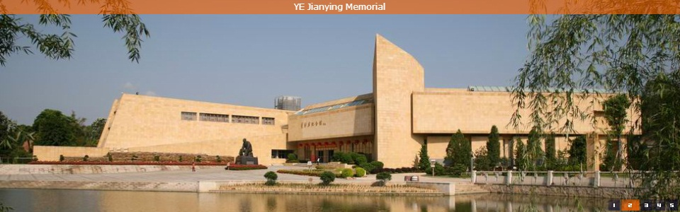
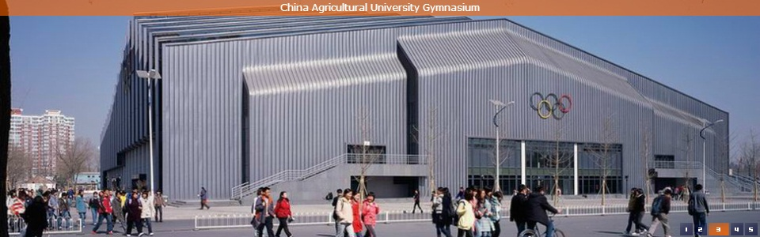
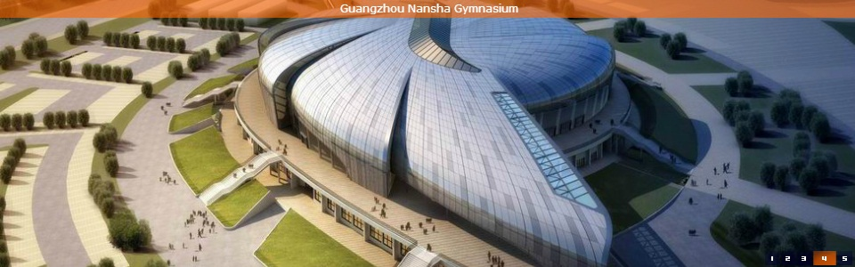
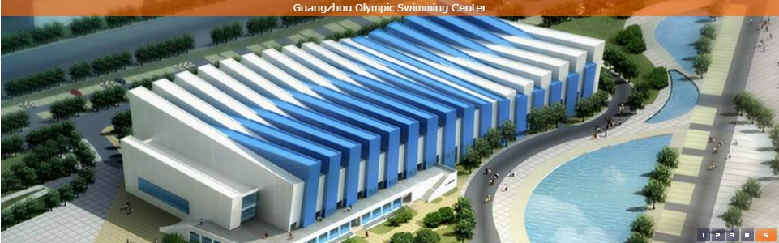
SCHOOL OF ARCHITECTURE

Slide 7
FACULTY & FACILITIES
Teaching and Administrative Staff
Faculty Type | Number
Total Num.of Faculty and staff | 308
Full-Time Teacher | 133
Professor | 32
Associate Professor | 49
Lecturer | 44
Teaching Associate | 1
Laboratory Staff | 4
Administrative Staff | 12

Slide 8
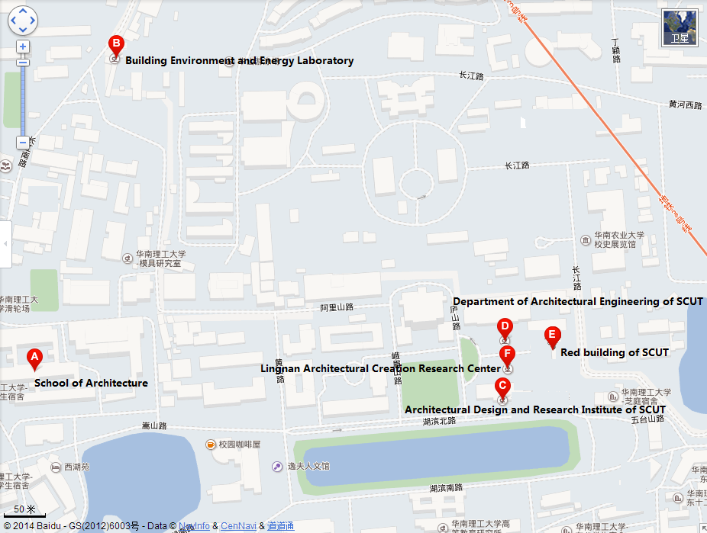
FACULTY & FACILITIES
Perfect Facilities

Slide 9

SCHOOLFELLOW
Top 1% students in the field of architecture of China
Nearly 30% have been admitted by top 50 Colleges worldwide in 2014
Over 90% have their ideal job when graduate

Slide 10
Majors & Study Plan
About Majors
Architecture
Urban planning
Landscape design
About Study Plan
General education course
Professional development courses

Slide 11
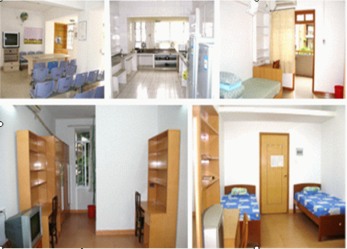
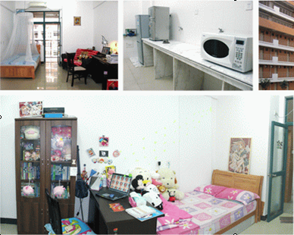
ACCOMMODATION
International Student Dorm
North Campus and South Campus -Building C15

Slide 12
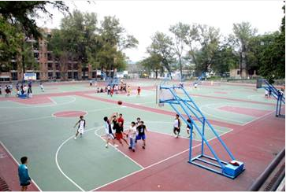
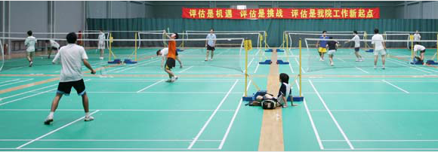
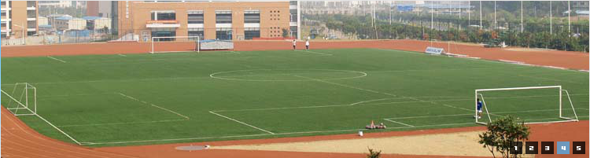
SPORTS & RECREATION
Basketball, Football, Tennis, Badminton, Skating rink , Swimming pool and so on.

Slide 13
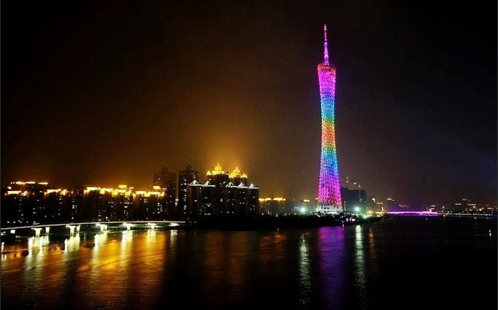
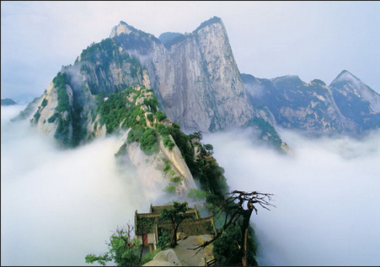
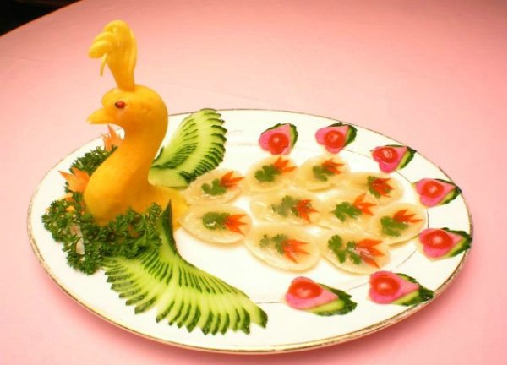
GUANGZHOU ATTRACTIONS
White Cloud Mountain
Canton Tower
Yue Cuisine

Slide 14
THANK YOU!

